Slide 1
“Slovak Economic Reform Experience.
Lessons for Croatia” Jan Oravec President The Entrepreneurs’ Association of Slovakia
Zagreb
June 7, 2016

Slide 2
SLOVAKIA-CROATIA
Four parallel historical and non-precedent transitions :
transition from a totalitarian Communist regime to a multiparty democracy
transition from a federation to an independent state
transition from a centrally planned economy to a market economy
transition from state paternalism to individual responsibility.
Facing just one of these challenges would be more than enough for one generation.

Slide 3
1993
SLOVAKIA
One Century
Compressed Into
One Decade
1993
2003
Ugly Little Duck of Central Europe
Shining Star of Reforms

Slide 4
SLOVAKIA 1993-2003-TODAY
1993
SLOVAKIA - OUTSIDER OF THE REGION (as a result of extremely negative expectations concerning future performance of the Slovak economy and „predicted“ overall early collapse of the Slovak economy)
2003
SLOVAKIA - DETROIT OF EUROPE (Volkswagen, Peugeot-Citroen, Kia Motors investing in Slovakia) and HONG KONG OF EUROPE (as a result of the Slovak economic and social reforms)
TODAY
SLOVAKIA – STANDARD EUROPEAN COUNTRY,
2000 – OECD
2004 – NATO and EU
2009 – EURO

Slide 5
1998-2006
1. 1998-2002:
1st wave of fundamental reforms - catching up with other transition countries
2. 2002-2006:
2nd wave of fundamental reforms - putting Slovakia ahead of other transition countries

Slide 6
1998-2002
1st wave of fundamental reforms helping Slovakia to catch up with other transition countries:
Macroeconomic stabilisation
Privatisation of banking sector, energy sector, and other previously “strategic” industries and companies
Deregulation of sensitive prices
Integration into international organisations (OECD, EU).

Slide 7
2002-2006
2nd wave of fundamental reforms putting Slovakia ahead of other transition countries:
Business Environment Reform
Labour Market Reform
Flat Tax Reform
Pension Reform
Education System Reform (1/2)
Health Care Reform (1/2)

Slide 8
Old Tax System
Dominated by special regimes and allowances:
Tax incentives for job creation, FDIs, deprived areas, etc.
Accelerated depreciation allowances for investment in certain assets
Favourable treatment of house ownership
Tax regimes favouring SMEs

Slide 9
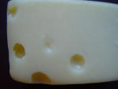
Tax Reform
Flat tax of 19 %
Simplification of the tax system
Old Tax System
New Tax System

Slide 10
TAX REFORM January 1, 2004
OLD SYSTEM
Personal Income Tax
5 tax brackets (10-38%)
Corporate Income Tax
25 %, previously 40 %
Dividend Tax
25 %
Value Added Tax
20 %, with reduced rate of 14 %
Real estate transfer tax
progressive taxation
Inheritance (Death) Tax, Gift Tax,
Various rates
NEW SYSTEM
Personal Income Tax
Flat tax of 19 %
Corporate Income Tax
19 %
Dividend Tax
ABOLISHED
Value Added Tax
19 %
Real estate transfer tax
flat tax of 3 %, ABOLISHED 2005
Inheritance (Death) Tax, Gift Tax,
ABOLISHED

Slide 11
TAX RATES FACED BY INVESTORS

Slide 12
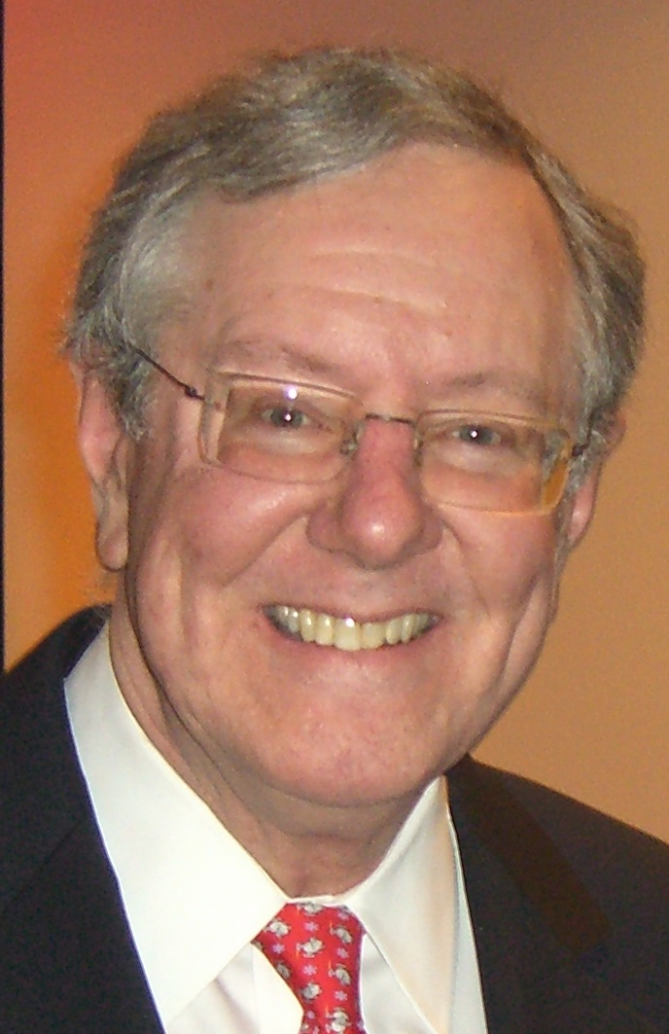
Tax Reform
Quick preparation and implementation:
September 2002: parliamentary elections
January 1, 2004: reform effective
2. Generating pressure on politicians and policy-makers long before (the 2nd half of 90-ies):
by NGOs promoting view: there are MAJOR FLAWS in the tax system, it needs FUNDAMENTAL FIX
by presenting inovative and attractive reform idea: FLAT TAX
by inviting opinion-makers from abroad to support reform change: Steve FORBES, US presidential candidate and owner of The Forbes magazine, campaigning for years with flat tax idea

Slide 13
Reform Follow-Up
2006-2010: the 1st socialist government after 1989
Criticising 1998-2006 policies
Not reversing their major symbols (tax and pension reforms), introducing minor modifications
2012-2015: the 2nd socialist – one party - government
Reversal of tax reform
Modification of pension reform

Slide 14
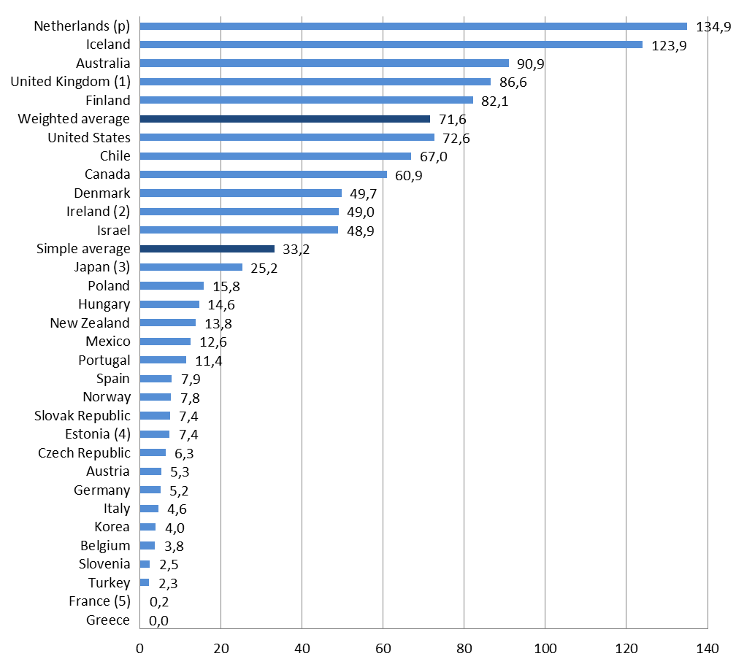
PENSION REFORM
Pension assets in SVK/GDP, 2010
as of January 1, 2005 privately owned personal pension accounts were created
65 % eligible citizens (1.5 mil.) opted for reformed system
50 % of their old age pension contribution (9 % of gross wage) was redirected from public to private pension system
The most robust contribution in Europe

Slide 15
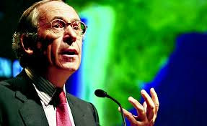
Pension Reform
Quick preparation and implementation:
September 2002: parliamentary elections
January 1, 2005: reform effective
2. Generating pressure on politicians and policy-makers long before (the 2nd half of 90-ies):
by NGOs promoting view: there are MAJOR FLAWS in the pension system, it needs FUNDAMENTAL FIX
by presenting innovative and attractive reform idea: individually owned personal pension savings accounts
by inviting opinion-makers from abroad to support reform change: José PINERA, the first architect of the successful pension reform

Slide 16
PENSION REFORM
2006
The 1st political test: the reformed system survived the first socialist government
2010
A liberal-conservative government reversed some of the changes introduced by socialist government
2012
Early elections, the 2nd socialist government:
Contributions reduced from 9 to 4 % as of Sept 1, 2012
Future increase of rates guaranteed by constitutional amendment agreed across political spectrum:
2017 | 2018 | 2019 | 2020 | 2021 | 2022 | 2023 | 2024
4.25 | 4.5 | 4.75 | 5.0 | 5.25 | 5.5 | 5.75 | 6.0

Slide 17
Reforms In Slovakia
Overall Very Positive Impact,
Internally as well as externally
_
+

Slide 18
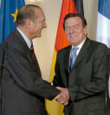
3 crucial conditions necessary for reforms
Open crisis - 1993-1998 ☹  (irresponsible macroeconomic policies, lack of microeconomic adjustments) and a sense of urgency of general public
Inspirations:
Responsive politicians ready to implement changes

Slide 19
LESSONS
Significant and quick improvements are possible
Reforms must be fundamental and quick (no gradualism and incrementalism)
Reforms must bring early results
Slow implementation of reforms undermine their sustainability in future
Even the best reforms tend to deteriorate, nothing is irreversible
Mechanisms to prevent achievements from deterioriating need to be introduced

Slide 20
POLICY MAKING TODAY
FOUR DEADLY SINS OF POLITICIANS
1. Ignorance of reality, creation of new myths
2. Inability to resist to a. paternalism in minds of citizens, b. rent-seeking by many businesses
3. Implementation of policies of interventionism and massive redistribution
4. Buying voters by taxpayers money

Slide 21
RESULTS OF Ignorance of Common Sense
Ugly world for businesses:
more regulation
more government restrictions
more and higher taxes
increased costs of doing business
limited economic freedoms

Slide 22
SLOVAKIA-CROATIA
COMMON CHALLENGES
GOOD REFORMS IMPLEMENTED IN THE PAST SHOULD BE PRESERVED
REFORM EFFORTS OF OTHER COUNTRIES MUST BE MONITORED AND
NECESSARY (FREEDOM ENHANCING!) REFORMS MUST BE IMPLEMENTED

Slide 24
FUTURE
The next wave of fundamental reforms needed
To improve competitivensess
To adjust to economic slowdown
To adjust unsustainable unfunded (social) liabilities

Slide 25
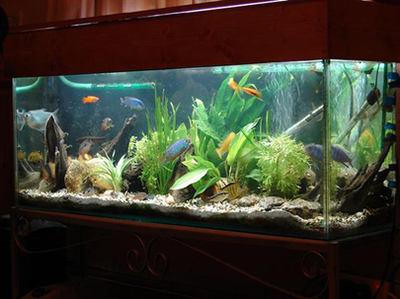
ECONOMY
NEEDS
Equal level playing field
Elimination of barriers
Elimination of policies that DISCRIMINATE majority of entrepreneurs by FAVOURING few (subsidies, grants, tax and other exemptions)
Encourge entrepreneurial spirit

Slide 26
SLOVAKIA-CROATIA
ULTIMATE AMBITION
Economic policy driven by one goal
Croatia/Slovakia
To
TOP TEN
in all competitiveness indeces!

Slide 27
Thank you for your attention! zps@zps.sk joravec64@gmail.com

